Slide 1
Human Computer Interaction
UE17CS424
HI-FI PROTOTYPE
Team:DHEERAJ REDDY PES1201700830
DR SAI PRANEETH PES1201701094
NAVEEN G PES1201701439
SYED ALI HUSSAIN PES1201802391

Slide 2


HI-FI PROTOTYPE

Slide 3
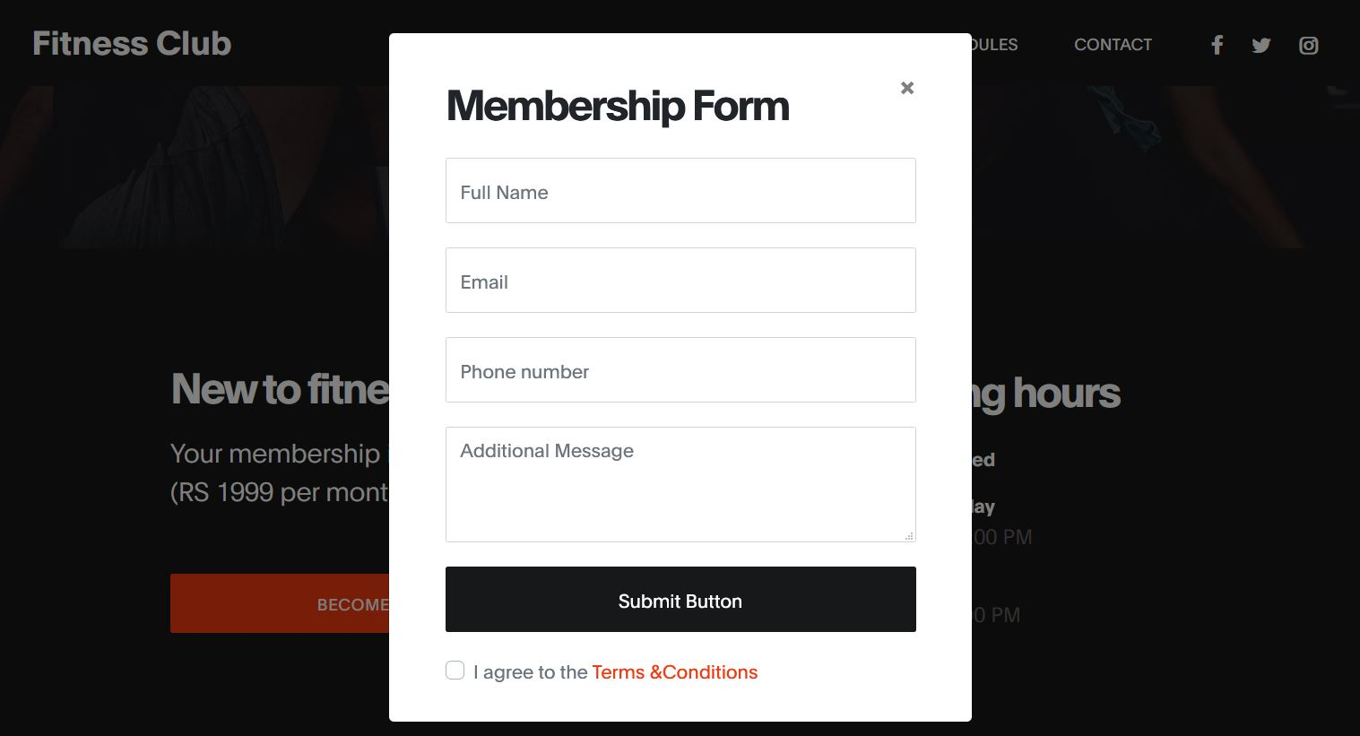
HI-FI PROTOTYPE

Slide 4
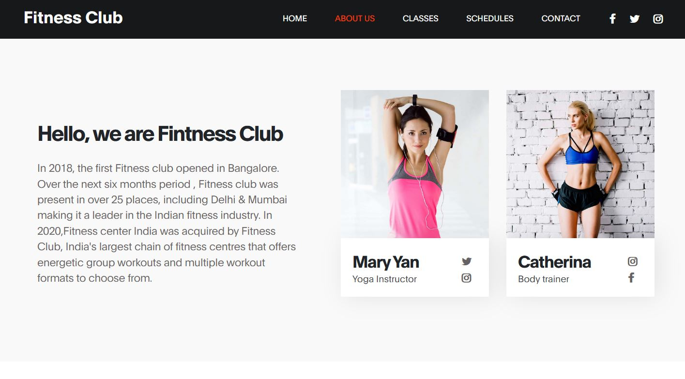
HI-FI PROTOTYPE

Slide 5

HI-FI PROTOTYPE

Slide 6
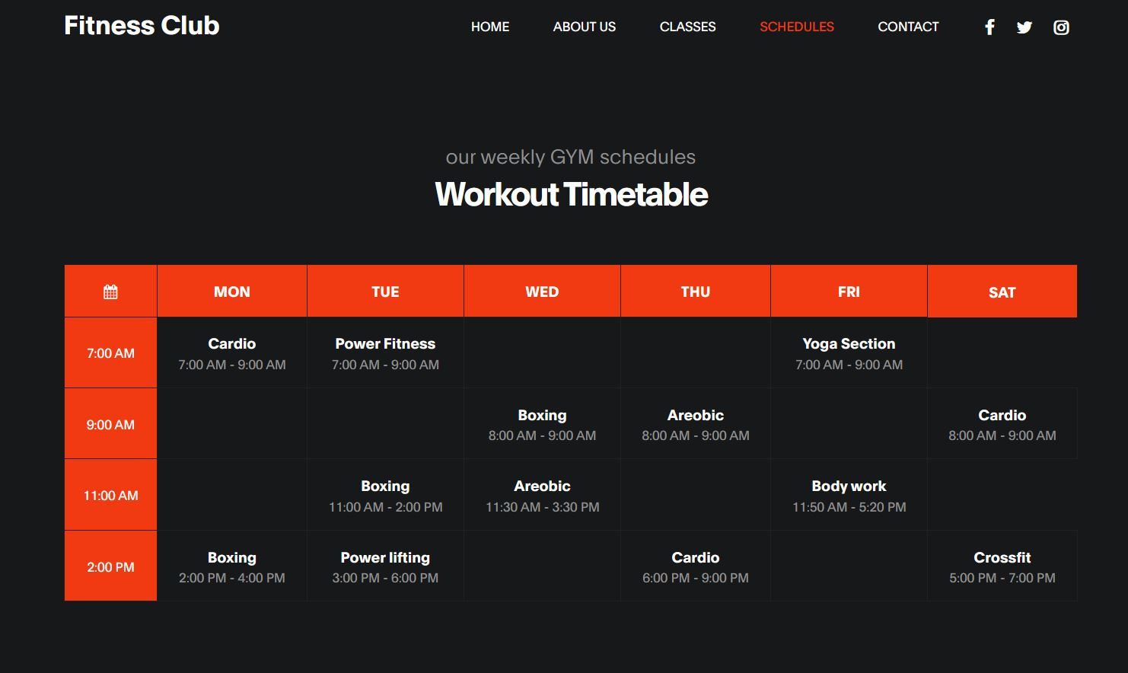
HI-FI PROTOTYPE

Slide 7
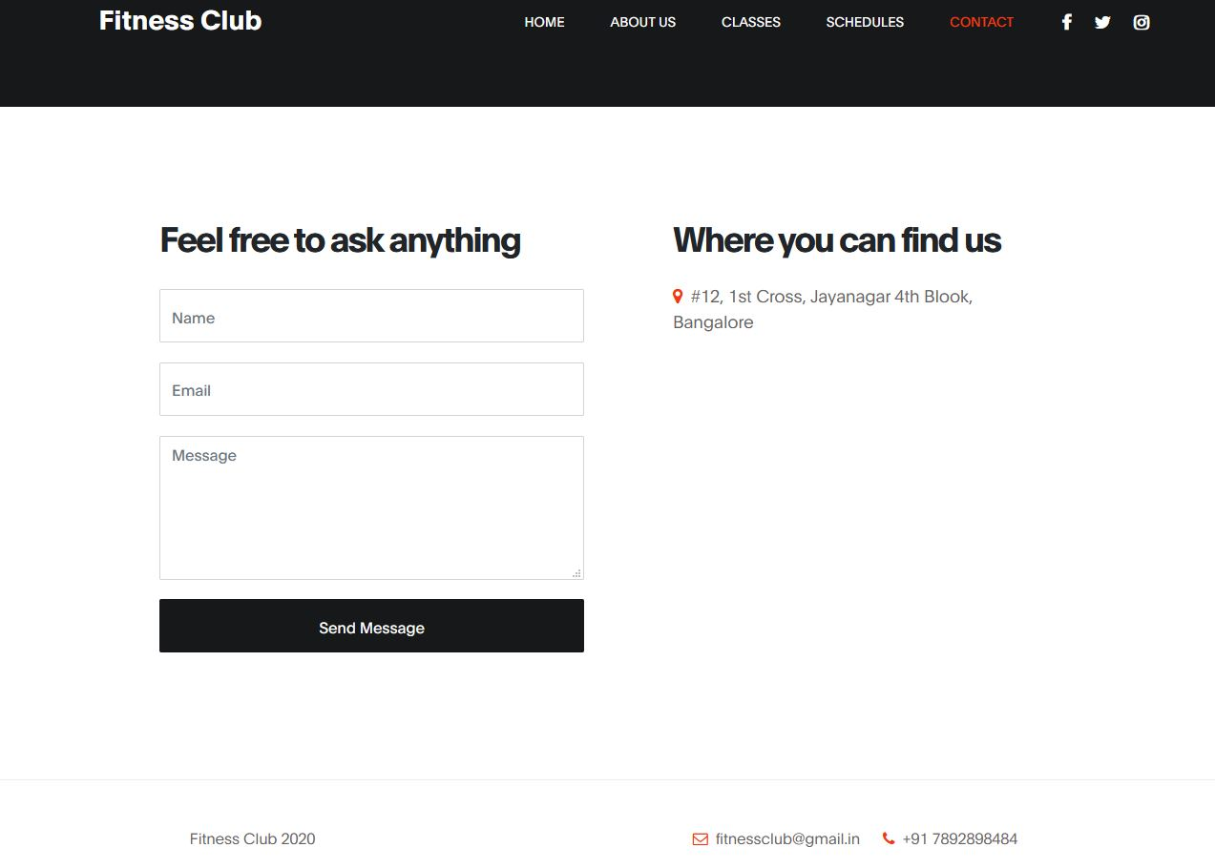
HI-FI PROTOTYPE

